Slide 1


MARKETING STRATEGIES
ROCKET
MORTGAGE
Present by :
Bhumi Lad
w0851209@myscc.ca

Slide 2


INTRODUCTION
Rocket Mortgage, a subsidiary of Rocket Companies, is a leading online mortgage lender based in Detroit, Michigan. Established in 1985 as Quicken Loans, it rebranded as Rocket Mortgage in 2015 to reflect its groundbreaking digital mortgage process. The company revolutionized the home financing industry by introducing a streamlined, fully online application process, making home loans faster, easier, and more accessible.
Rocket Mortgage is also known for its extensive customer support, competitive rates, and commitment to financial education. By leveraging technology and focusing on user experience, Rocket Mortgage continues to set industry standards for efficiency and customer satisfaction.

Slide 3


DATA
DESCRIPTION
Assets
Liabilities
Borrowers
Credit Reports
Income
Mortgage

Slide 4

SITUATION ANALYSIS
Strengths
Weaknesses
Strong Brand Recognition
Technology Leadership
Customer Experience
Large Market Share
Efficient Process
Dependence on the U.S. Market
Limited Face-to-Face Interactions
High Marketing Costs
Opportunities
Threats
Expanding into New Markets
Partnerships and Diversification
Technological Advancements
Rising Demand for Digital Services
Regulatory Changes
Intense Competition
Economic Downturn
Cybersecurity Risks

Slide 5
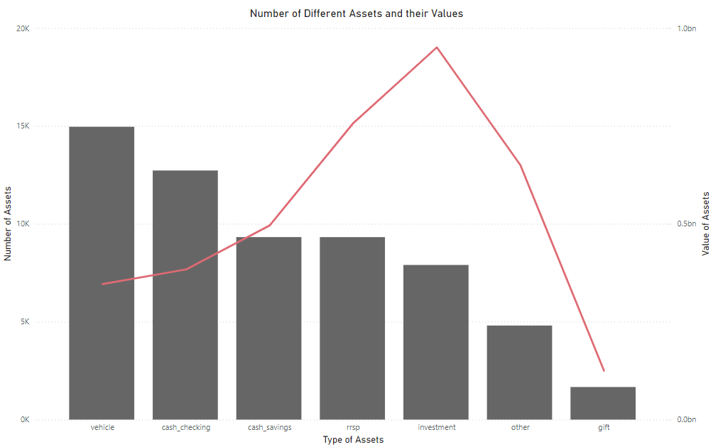

ASSETS

Slide 6
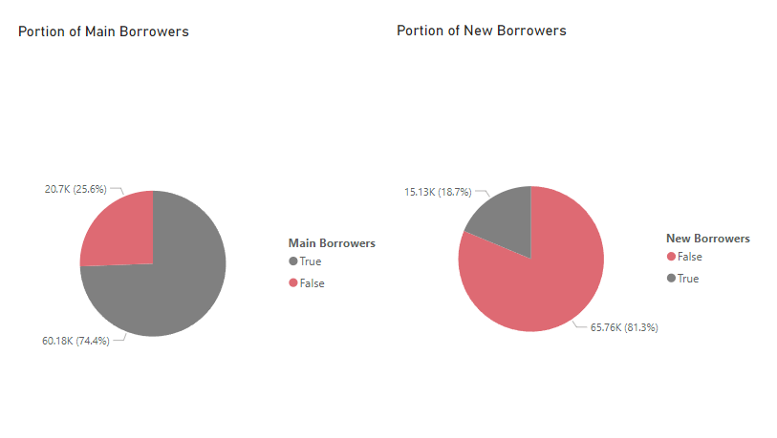
BORROWERS

Slide 7
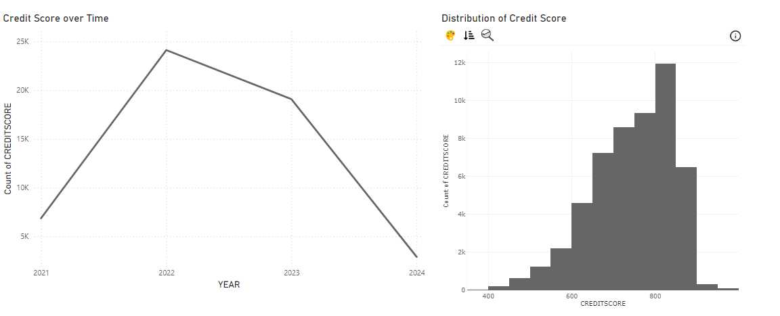
CREDIT SCORES

Slide 8
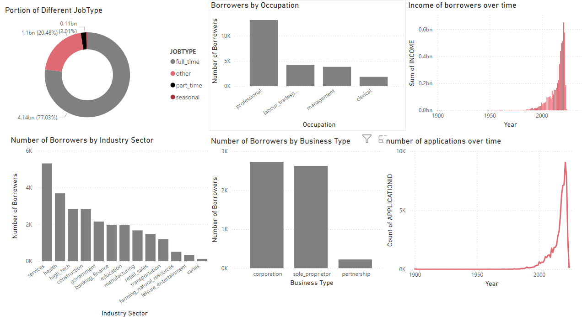
INCOMES

Slide 9
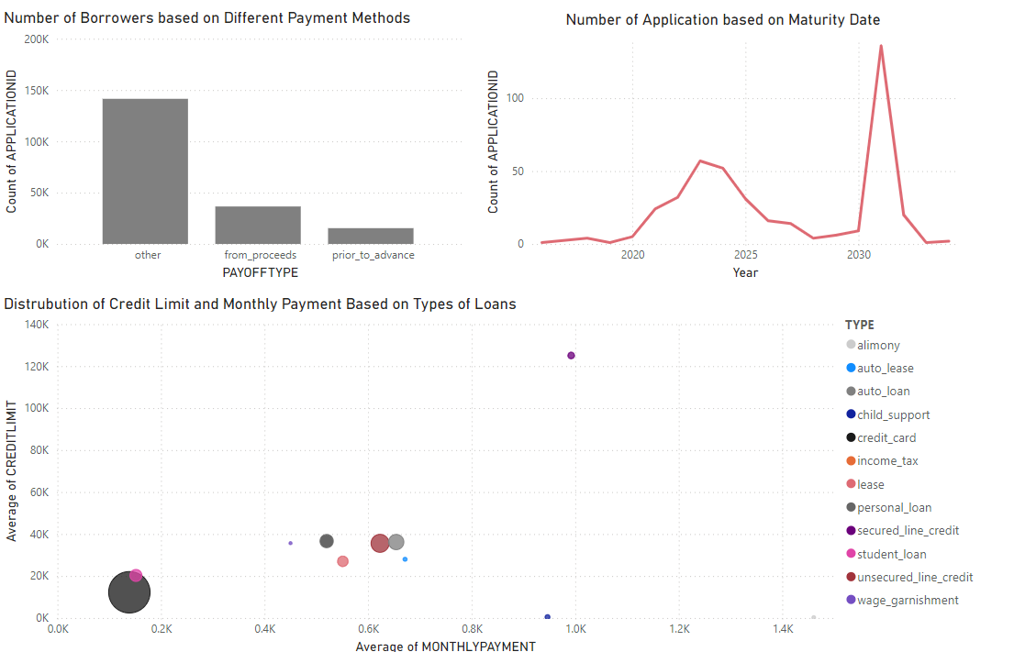
LIABILITIES
Notes:
direct cash payments, checks, third-party transfers

Slide 10
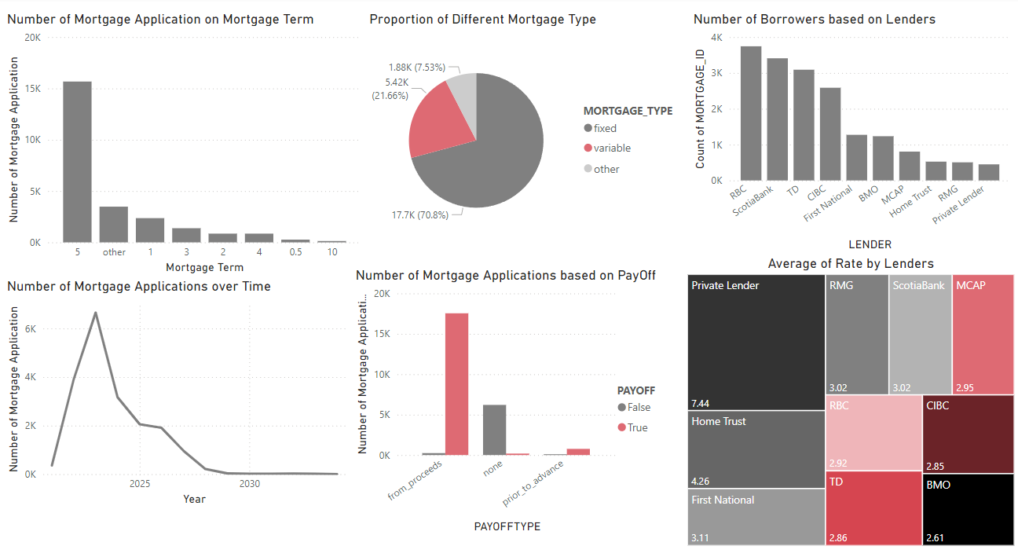
MORTGAGES

Slide 11
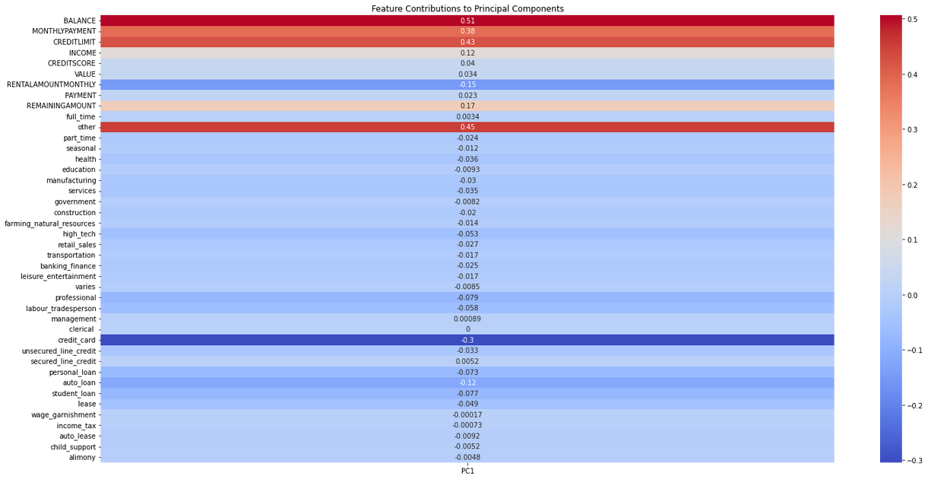
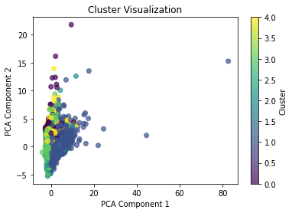
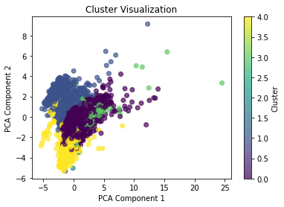
CUSTOMER SEGMENTATION
Customer segmentation divides borrowers into groups based on traits like income, credit score, and loan type, enabling Rocket Mortgage to meet specific needs and deliver personalized marketing.
Inertia1 : 1268505.0143641222
Inertia2 : 1146048.8771257587

Slide 12
MARKETING STRATGIES
Targeted Email Promotions: Leverage high-income and high-credit score borrowers for personalized loan offerings.
Loan Education for Students: Host seminars or provide tutorials to educate students about loan options and financial planning.
Bank Partnerships: Collaborate with banks and institutions to expand reach and improve customer trust.
Billboards at Labor and Trade Locations: Utilize high-traffic labor and trade areas for impactful advertising.
Expanding with Geographical Segmentation: Identify and target high-potential regions for market growth.

Slide 13


Thank you for your time!
BHUMI LAD

